Slide 1
Data Science Capstone Project
Sports Complex in Toronto: Evaluating the best neighbourhoods to build a sports complex using a K-means clustering algorithm

Slide 2
The Problem
Business Statement: we are approached by a development company that wants to build a sports complex in one of the neighbourhoods in Toronto. They wish to find the optimal place to live to help minimize competition and maximize revenue.
Analytical Problem: Where we should build a new sports complex based on existing venues to minimize competition with other exercise related venues?

Slide 3
Data Sets
Neighbourhood Data
Obtained from postal code database
Allows us to divide Toronto into defined boundaries
Key to performing segmentation
Location Data
Obtained from GeoPy
Contains longitude and latitude of neighbourhoods in Toronto
Used to perform the Clustering algorithm to locate venues within neighbourhoods
Venue Data
Obtained from Foursquare API
Contains relevant information such as proximity to fitness center gyms

Slide 4
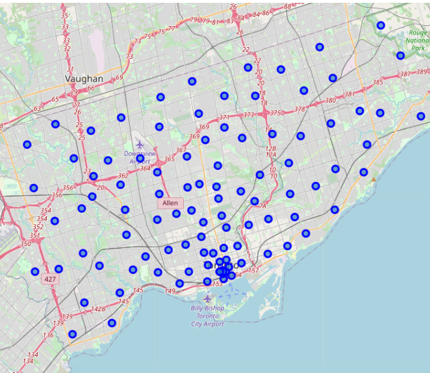
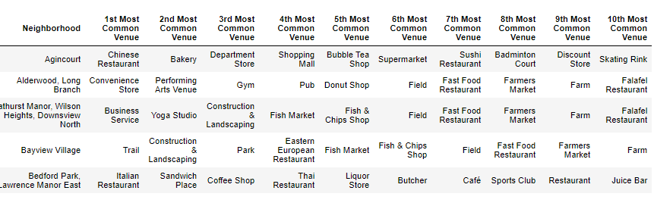
Methodology – Part 1
Explore data and create visualizations
Create a map of the Toronto neighbourhoods
Build a list of venues in each neighbourhood

Slide 5
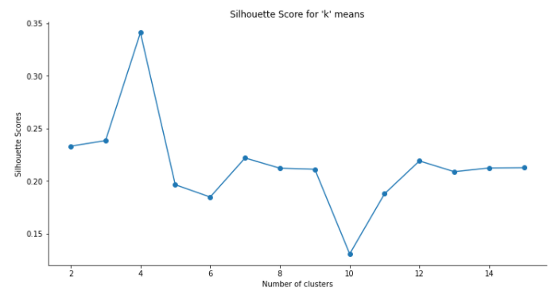
Methodology – Part 2
Build Model
Supervised Learning: K- means clustering algorithm to perform segmentation on Toronto neighbourhoods
Determine the key parameter for number of clusters using silhouette score
Optimal is 4 clusters

Slide 6
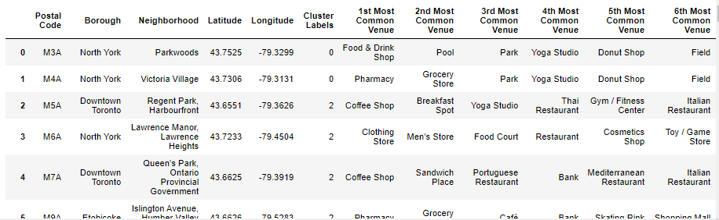
Results
Labels on the neighbourhoods

Slide 7
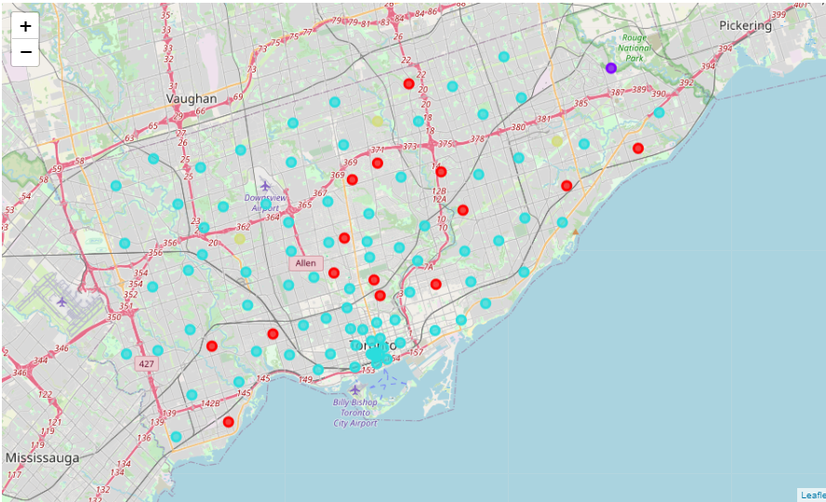
Folium map of results
Red- Cluster 1
Purple – Cluster 2
Light Blue – Cluster 3
Yellow – Cluster 4

Slide 8
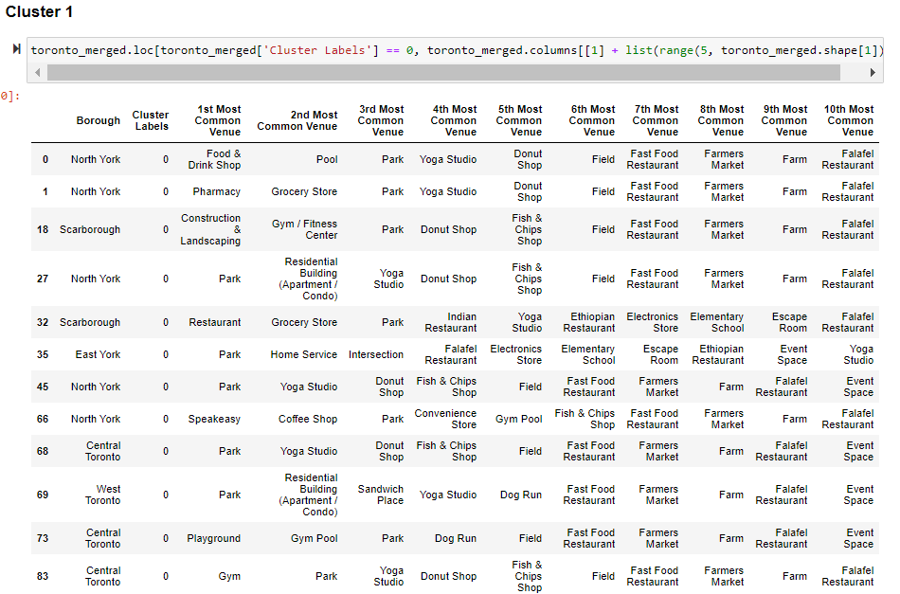
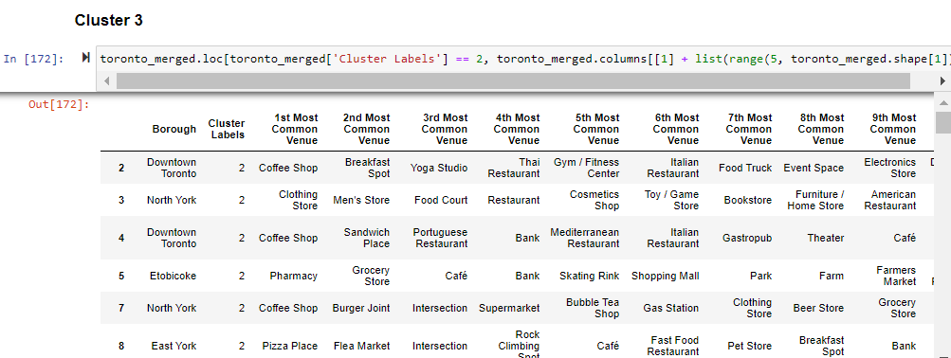
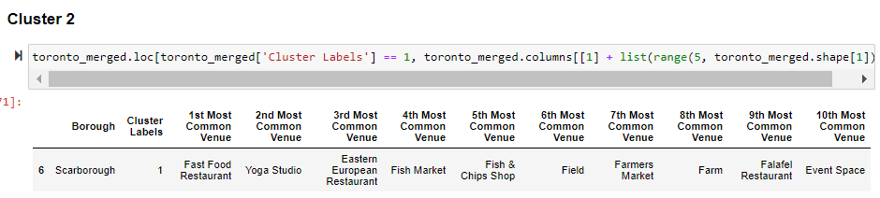
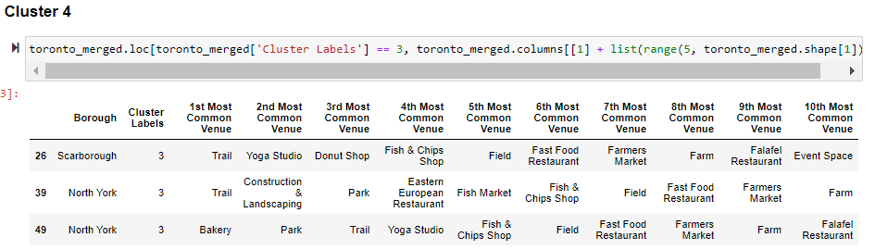
Resulting Clusters

Slide 9
Final Recommendation
By analyzing the four clusters obtained we can see that some of the clusters are more suited for a location for a new sports complex
Clusters 1,2 and 4 contain many fitness and exercise related areas
Cluster 3 contains mostly restaurants
Neighbourhoods labelled with cluster 3 are optimal locations for minimizing competition for a new sports complex!!

